Slide 1
Writing in Applied Fields Technical Writing 1
Common Grammar and Style Recommendations
Donald R. Jones, Ph.D.

Slide 2
Source
Source material for this PowerPoint presentation include,
Writing the Empirical Journal Article, by Daryl J. Bem, in Darley, J. M., Zanna, M. P., & Roediger III, H. L. (Eds) (2002). The Compleat Academic: A Career Guide. Washington, DC: American Psychological Association, and
Publication Manual of the American Psychological Association, sixth Edition.

Slide 3
This Talk
Quiz
Covers commonly encountered situations where writers frequently make mistakes.
Does not cover most basic rules of English grammar.
Does not cover idiosyncratic rules that everyone has to look up.

Slide 4
Which article should you write?
The term “article” can apply to whatever you are writing, such as term paper, project proposal, or results of an analytics project.
There are two possible articles you can write:
the article you planned to write when you designed your study or
(2) the article that makes the most sense now that you have seen the results.
The Correct Answer

Slide 5

How should you write?
First strive for accuracy and clarity.
The first step toward clarity is good organization.
The second step toward clarity is to write simply and directly.
… is not a novel with subplots, flashbacks, and literary allusions, but a short story with a single linear narrative line. Let this line stand out in bold relief.

Slide 6
For whom should you write?
The broadest audience possible.
I see you trying to ignore this. Now repeat after me, “THE BROADEST AUDIENCED POSSIBLE.

Slide 7

Thank goodness, this proposal is in plain language that I can understand!

Slide 8
For whom should you write?
The broadest audience possible.
Bem says, “Good writing is good teaching.”

Slide 9
Use active voice of verbs.
1. The data were analyzed….
2. We analyzed the data….

Slide 10
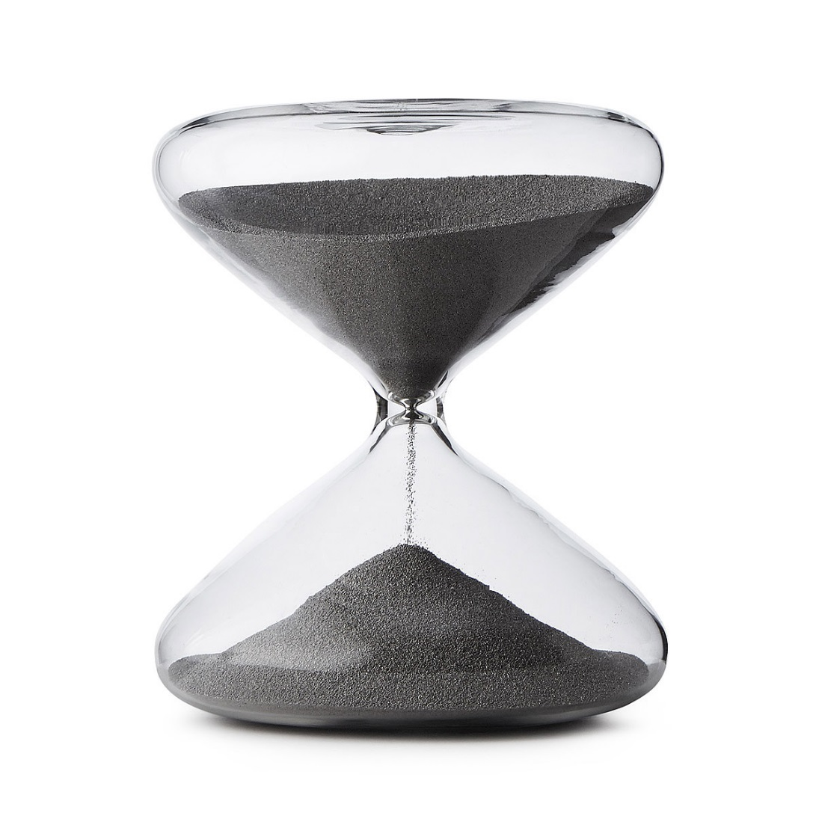
What is the shape of what you are writing?

Slide 11

What is the shape of what you are writing?

Slide 12
Bem pages 5-15. All good stuff, but especially note the following.
Opening statement (p5). Use prose. See Bem’s examples.
Use illustrative examples for technical material.
Use references, but don’t make the sentence about the reference (Bem, p 8).

Slide 13
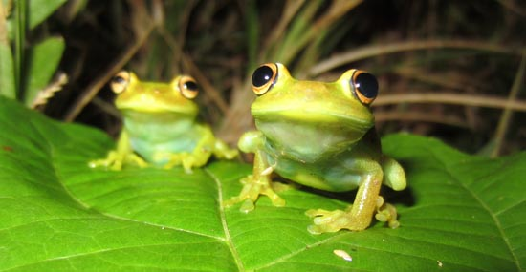
Bem pages 5-15. All good stuff, but especially note the following.
“Name all groups, variables, and operations with easily recognized and remembered labels. Don’t use abbreviations (the AMT5% group) or empty labels(Treatment 3). Instead, tell us about the success group and the failure group, the father-watching condition and the mother-watching condition, the teacher sample and the student sample, and so forth. It is also better to label groups or treatments in operational rather than theoretical terms. It is difficult to remember that it was the high dissonance group that was offered the small incentive and the low dissonance group that was offered the large incentive. So tell us instead about the $1 group and the $20 group. You can remind us of the theoretical interpretation of these variables later when you discuss the results. “ (Bem, Page 9).
You’d be amazed how often students mess this up.
Are they lazy?
No, they forget that not everyone remembers what their arcane variable names are supposed to mean.
Makes them look lazy, though.

Slide 14
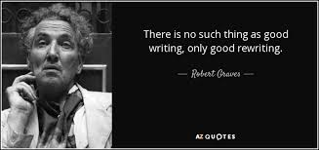
Rewrite it!

Slide 15
Avoid hedging language
Our results seem to imply….
Our results imply….
Our results more or less imply

Slide 16
Rewrite it!
“Rewriting is difficult for several reasons. First, it is difficult to edit your own writing. You will not notice ambiguities and explanatory gaps because you know what you meant to say and you understand the omitted steps. One strategy for overcoming this difficulty is to lay your manuscript aside for awhile and then return to it later when it has become less familiar. Sometimes it helps to read it aloud. But there is no substitute for practicing the art of taking the role of the nonspecialist reader, for learning to role-play grandma. As you read, ask yourself, “Have I been told yet what this concept means?” Has the logic of this step been demonstrated?” “Would I know what the independent variable is at this point?” This is precisely the skill of the good lecturer in …, the ability to anticipate the audience’s level of understanding at each point in the presentation. Good writing is good teaching.” (Bem page 16.)

Slide 17
Could you turn this….
Omit Needless Words
Virtually all experienced writers agree that any written expression that deserves to be called vigorous writing, whether it is a short story, an article for a professional journal, or a complete book, is characterized by the attribute of being succinct, concise, and to the point. A sentence—no matter where in the writing it occurs—should contain no unnecessary or superfluous words, words that stand in the way of the writer’s direct expression of his or her meaning and purpose. In a very similar fashion, a paragraph—the basic unit of organization in English prose—should contain no unnecessary or superfluous sentences, sentences that introduce peripheral content into the writing or stray from its basic narrative line. It is in this sense that a writer is like an artist executing a drawing,and it is in this sense that a writer is like an engineer designing a machine.Good writing should be economical for the same reason that a drawing should have no unnecessary lines, and good writing should be streamlined in the same way that a machine is designed to have no unnecessary parts, parts that contribute little or nothing to its intended function.This prescription to be succinct and concise is often misunderstood, and requires judicious application. It certainly does not imply that the writer must make all of his or her sentences short and choppy or leave out all adjectives, adverbs, and qualifiers. Nor does it mean that he or she must avoid or eliminate all detail from the writing and treat his or her subjects only in the barest skeleton or outline form. But the requirement does imply that every word committed to paper should tell something new to the reader and contribute in a significant and nonredundant way to the message that the writer is trying to convey. (Bem, page 17).
(See next page.)

Slide 18
…into this?
Vigorous writing is concise. A sentence should contain no unnecessary words, a paragraph no unnecessary sentences, for the same reason that a drawing should have no unnecessary lines and a machine no unnecessary parts. This requires not that the writer make all sentences short or avoid all detail and treat subjects only in outline, but that every word tell. [59 words]
This essay on brevity was written by Strunk and White (2000, p. 23) under
the heading: “Omit Needless Words.” Obey their injunction, for it is the most important
piece of advice in this article.
(Bem, page 17)

Slide 19
Use past tense when describing what you (or other researchers) did.
1. We analyze earnings
of 100 companies…
2. We analyzed earnings
of 100 companies…

Slide 20
Use present tense when talking about the manuscript or its implications.
1. This paper reported the results of an investigation of….
2. This paper reports the results of an investigation of …

Slide 21
Subject and verb should agree as to number.
The data was analyzed by…
The data were analyzed by….
The data set was analyzed by….

Slide 22
Subject and verb should agree as to number.
Each person received their compensation.
Each person received his compensation.
All participants received their compensation.
Preferred because gender neutral

Slide 23
Present parallel ideas in parallel form.
The participants were told to make themselves comfortable, to read the instructions, and to ask about anything they did not understand.
The participants were told to make themselves comfortable, to read the instructions, and that they should ask about anything they did not understand.

Slide 24
Bem says, page 19.
Repetition and parallel construction are among the most effective servants of clarity. Don’t be creative, be clear.

Slide 25
Present parallel form in lists.
There are three ways to catch a fish. First you can use a net. Second, you can use a hook and line. Third, you can use a harpoon.
There are three ways to catch a fish. First you can use a net. Of course you can use a hook and line. Without doubt you can use a harpoon.

Slide 26
Present parallel form in numbered lists.
There are three ways to catch a fish, which are (1) use a net, (2) take advantage of any available a hook and line, and (3) throw a harpoon at the little swimmers.
There are three ways to catch a fish, which are (1) use a net, (2) use a hook and line, and (3) use a harpoon.

Slide 27
Use a comma in a series of three or more items, including before and and or.
1. In the zoo there were tigers,
lions, and zebras.
2. In the zoo there were tigers,
lions and zebras.

Slide 28
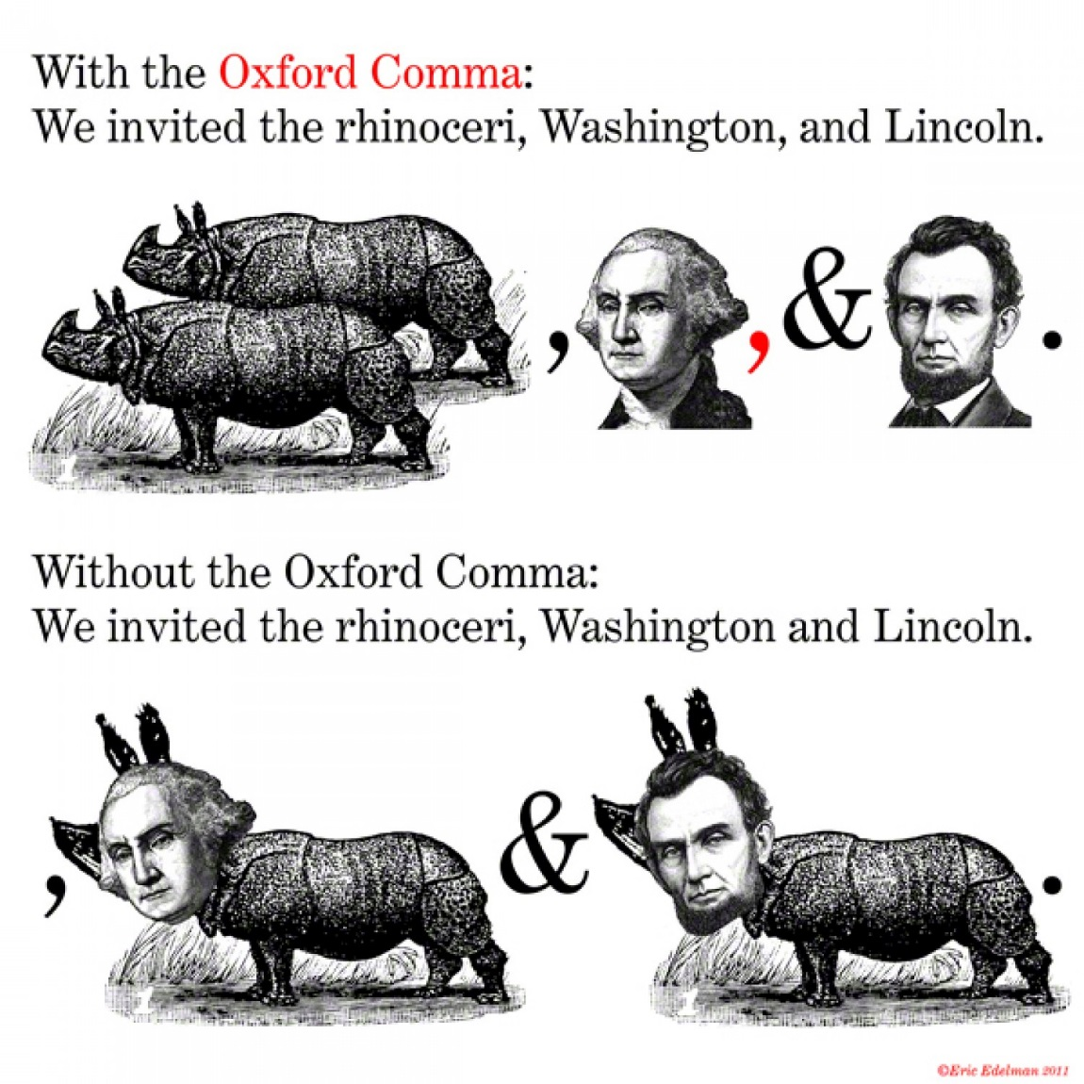
This is called the Oxford Comma. Use it!

Slide 29
Use two commas to set off a nonessential clause
1. The investors, seemingly in a good mood, wrote checks
2. The investors, seemingly in a good mood wrote checks.

Slide 30
Do not use commas to set off an essential clause.
1. The banks with high enough liquidity were able to make loans.
2. The banks, with high enough liquidity, were able to make loans.

Slide 31
Use a colon after an introductory clause that could stand as a complete sentence.
They have agreed on the outcome: informed participants perform better than uninformed participants.
The instructions were: go to the starting line and wait for the starting signal.

Slide 32
Which or that? That clauses are essential while which clauses are merely informative.
The questions that led to bad answers were removed from the survey.
The questions which led to bad answers were removed from the survey
The questions, which were considered hard, accomplished their objective.

Slide 33
Numerals or words? Usually use numerals, but use words at the beginning of a sentence.
Our results showed that 80 percent of doctoral students want to become professors.
80 percent of doctoral students want to become professors.
Eighty percent of doctoral students want to become professors.

Slide 34
Define an abbreviation the first time it appears.
Those who write about management information systems (MIS) often use the term MIS.
Those who write about MIS often use the term MIS.

Slide 35
Avoid Language Bias – See Bem pp 21-23
Research participants
Sex and Gender
Racial and Ethnic Identity
Sexual Orientation
Disabilities
[Read these pages carefully and learn to write respectfully.]

Slide 36
Common Errors- Bem pp. 23-24.
Learn these errors so you can avoid them.

